Slide 1

Networking Project
Comprehensive network design of a company with two floors or more.

Slide 2
Contents of this presentation
Introduction | Just a quick introduction about the project.
Team Members | Introducing team members and their roles in the project.
Project Description | Description of the poroject and what it can do.
Project Overview | Explaining the project.
Conclusion | Description of the problems that the project overcame.
Group Code:- SHR1_ISS2_S1e
Track:- CISCO network administration

Slide 3
Introduction
In a rapidly growing organization, expansion often brings new challenges. One such challenge is designing a robust and scalable network for a new building housing number of employees. With multiple departments spread across three floors, a seamless and secure network infrastructure is essential to support daily operations. This project focuses on implementing a future-proof network solution using a hierarchical model, ensuring redundancy, security, and scalability. Leveraging technologies like VLANs, OSPF, and DHCP, the design aims to meet current needs while allowing for future growth.

Slide 4





Our Amazing Team
Mohamed Salama
Ahmed Elsayed
Shahd Mahmoud
Mohamed Shehta
Yasser Elsayed
1- Hierarchical Network Design.
2- Subnetting and IP Addressing.
3- Configuring Dedicated DHCP Server device to provide dynamic IP allocation.
4- Configuring OSPF as the routing protocol.
1- Creating a network topology using Cisco Packet Tracer.
2- Connecting Networking devices with Correct cabling.
3- Configuring Basic device settings.
4- Static Addressing: Allocate static IP addresses to devices.
1- Configuring switchport security or Port-Security on the switches
2- Configuring WLAN or wireless network
3- Configuring ISP routers.
4- Configuring NAT Overload.
5- Load balancing using HSRP protocol.
1- Creating VLANs and assigning ports VLAN numbers.
2- Configuring Inter-VLAN Routing on the Multilayer switches.
3- Configuring SSH for secure Remote access.
4- VoIP: Deploy IP phones in each department.
1-Host Device Configuration.
2- Test and Verifying Network Communication.
3- Configuring standard and extended Access Control Lists ACL.
4- Cisco ASA Firewall: Configure default static routes, basic settings, security levels, zones,

Slide 5
Project Description
This project involves designing and implementing a network for a new building housing 600 staff across six departments. Using a hierarchical model with redundancy at each layer, the network will ensure reliability and security. Key features include VLAN configuration, subnetting, OSPF routing, and dynamic IP addressing via DHCP. Wireless connectivity will be provided for all departments, with port security in place for sensitive areas. The network will also connect to two ISPs for high availability.

Slide 6
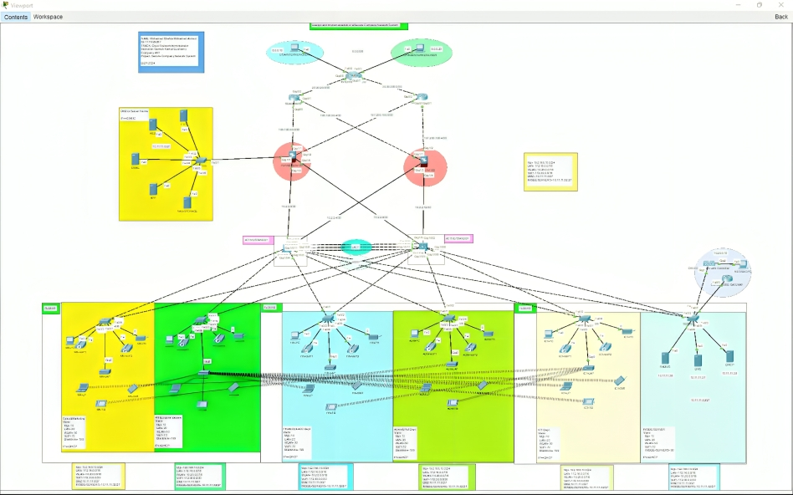
A picture is worth
a thousand words

Slide 7
Conclusion
In conclusion, this project delivers a robust, scalable, and secure network solution tailored to the organization’s needs. The design ensures redundancy, efficient data flow, and secure communication between departments. By leveraging advanced technologies like OSPF, VLANs, and DHCP, the network is prepared for both current demands and future growth. This solution will enable seamless operations and support the company’s ongoing expansion.

